Slide 1

Corrspell-spell corrector

Slide 2
PROJECT OVERVIEW
Problem Statement
Objectives
Scope

Slide 3
Problem Statement
The "corrspell" project aims to develop a spelling correction tool using deep learning approaches. The tool is designed to identify and correct spelling errors in text, considering various types of spelling errors, including non-word errors, real-word errors, cognitive errors, and short forms/slang/lingo.

Slide 4
Objectives
Build a spelling correction model that can automatically correct misspelled words.
Handle different types of spelling errors, such as non-word errors, real-word errors, cognitive errors, and short forms.
Implement the spell correction logic to suggest or automatically replace misspelled words.
Provide an easy-to-use interface for users to input text and receive corrected output.

Slide 5
Scope
The project's scope includes developing a spelling correction tool and a user-friendly interface. It uses deep learning techniques for spell correction and is primarily built using Python and Keras with TensorFlow GPU backend.

Slide 6
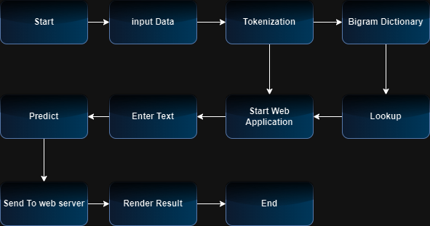
Architecture

Slide 7
Technology Stack
Programming Languages and Frameworks
Python 3.6
Keras 2.2.4 with TensorFlow GPU 1.14.0 backend

Slide 8
Installation
Setting Up the Environment
To create a virtual environment for the project, follow these steps:
Using PyCharm:
Create a new project.
Navigate to the project directory.
Select the option to create a new virtual environment using conda with Python 3.6.
Finally, create the project using the selected resources.

Slide 9
Installation
Using Conda:
Create a new virtual environment using the command: conda create -n your_env_name python=3.6
Navigate to the project directory.
Install the necessary packages from requirements.txt using the command: pip install -r requirements.txt

Slide 10
Project Structure
Directory Structure
project_directory
── requirements.txt
── spellingcorrector.py
── application.py
── …….

Slide 11
Project Structure
Description of Key Files
requirements.txt: Lists project dependencies.
spellingcorrector.py: Contains the implementation of the spell correction logic.
application.py: Entry point of the application with a Flask-based user interface.

Slide 12
Workflow
SymSpell Configuration
SymSpell is configured with specific parameters for spelling correction, including maximum dictionary edit distance and dictionary files.
Edit Distance Calculation
Edit distance between two strings is calculated using a specific algorithm to identify misspelled words.

Slide 13
Workflow
Spell Correction Logic
The project implements the logic for correcting spelling errors, suggesting alternatives, and retaining correctly spelled words.
Input and Output Handling
The application handles input from users, performs spell correction, and presents the corrected output to users.

Slide 14
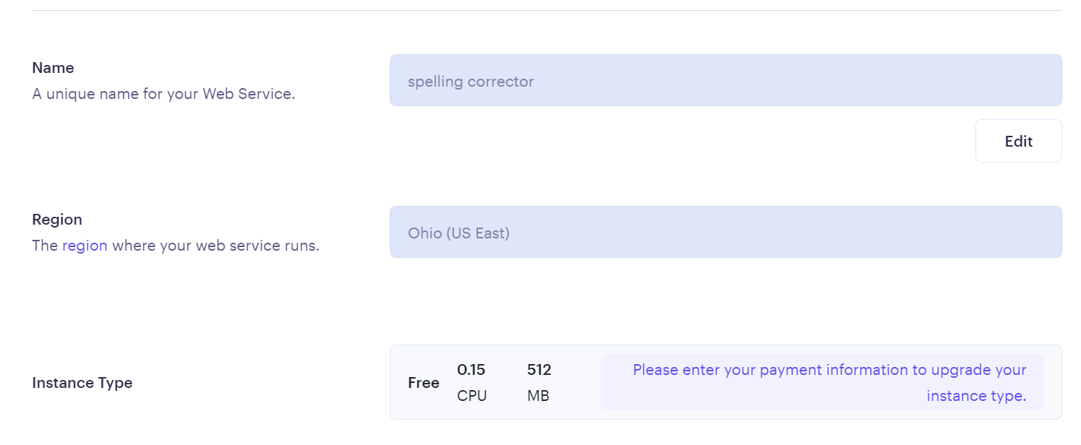
Deployment on Render
Setting Up the Render Environment

Slide 15
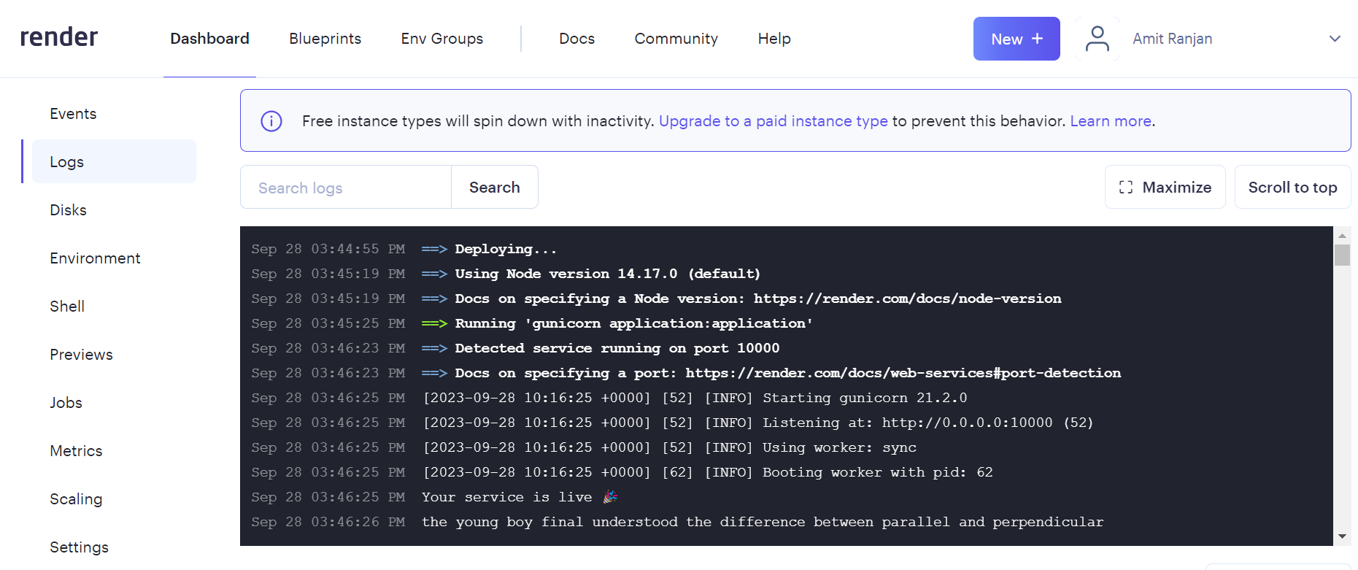
Deployment on Render
Deployment Process

Slide 16
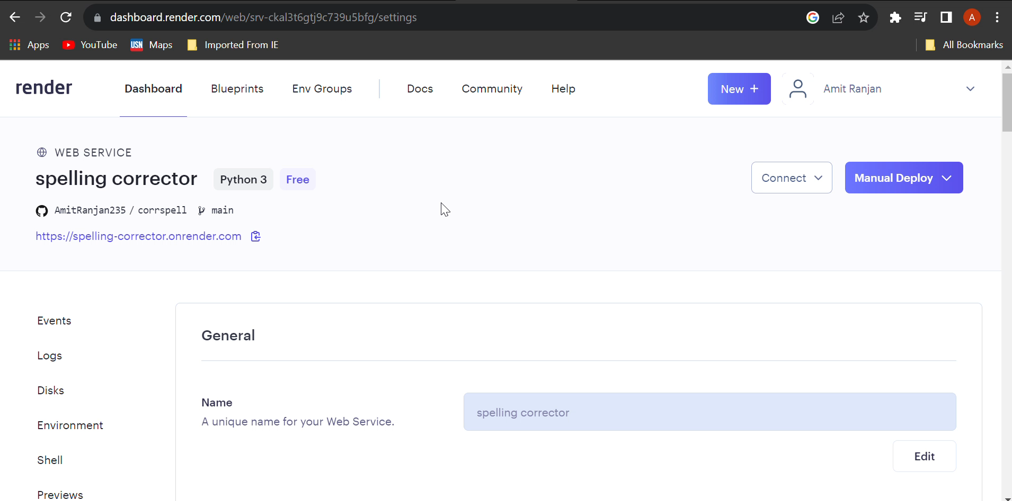
App Running video

Slide 17
Conclusion
Project Summary
The "corrspell" project successfully implements a spelling correction tool that can handle multiple types of spelling errors.
Achievements
Developed a spelling correction model using deep learning.
Created a user-friendly interface for spell correction.

Slide 18
Conclusion
Lessons Learned
Gain experience with deep learning and natural language processing.
Understand the challenges of spelling correction.
Future Enhancements
Consider using pretrained models like BERT or GPT-2 for improved accuracy.
Expand the training dataset for better predictions.
Live web App link: corrspell

Slide 19

Thank You
Amit Ranjan

